Slide 1

Cryptography and Network Security
Seventh Edition
by William Stallings
Notes:
Lecture slides prepared for “Cryptography and Network Security”, 7/e, by William Stallings, Chapter 2 – “Introduction to Number Theory”.

Slide 2
Chapter 2
Introduction to Number Theory
Notes:
Number theory is pervasive in cryptographic algorithms. This chapter provides
sufficient breadth and depth of coverage of relevant number theory topics for understanding
the wide range of applications in cryptography. The reader familiar with these
topics can safely skip this chapter.
The first three sections introduce basic concepts from number theory that are
needed for understanding finite fields; these include divisibility, the Euclidian algorithm,
and modular arithmetic. The reader may study these sections now or wait until
ready to tackle Chapter 5 on finite fields.
Sections 2.4 through 2.8 discuss aspects of number theory related to prime numbers
and discrete logarithms. These topics are fundamental to the design of asymmetric
(public-key) cryptographic algorithms. The reader may study these sections now or
wait until ready to read Part Three.
The concepts and techniques of number theory are quite abstract, and it is often
difficult to grasp them intuitively without examples. Accordingly, this chapter includes
a number of examples, each of which is highlighted in a shaded box.

Slide 3
Divisibility
We say that a nonzero b divides a if a = mb for some m, where a, b, and m are integers
b divides a if there is no remainder on division
The notation b | a is commonly used to mean b divides a
If b | a we say that b is a divisor of a
The positive divisors of 24 are 1, 2, 3, 4, 6, 8, 12, and 24
13 | 182; - 5 | 30; 17 | 289; - 3 | 33; 17 | 0
Notes:
We say that a nonzero b divides a if a=mb for some m, where a, b, and m are integers. That is, b divides a if there is no remainder on division.
The notation b | a is commonly used to mean b divides a . Also, if b | a , we say that b is a divisor of a .

Slide 4
Properties of Divisibility
If a | 1, then a = ±1
If a | b and b | a, then a = ±b
Any b ≠ 0 divides 0
If a | b and b | c, then a | c
If b | g and b | h, then b | (mg + nh) for arbitrary integers m and n
11 | 66 and 66 | 198 = 11 | 198
Notes:
Subsequently, we will need some simple properties of divisibility for integers, which are as follows:
• If a|1, then a = ±1.
• If a|b and b|a, then a = ±b.
• Any b ≠ 0 divides 0.
• If a | b and b | c, then a | c
• If b|g and b|h, then b|(mg + nh) for arbitrary integers m and n.

Slide 5
Properties of Divisibility
To see this last point, note that:
  If b | g , then g is of the form g = b * g₁ for some integer g₁
  If b | h , then h is of the form h = b * h₁ for some integer h₁
So:
  mg + nh = mbg₁ + nbh₁ = b * (mg₁ + nh₁ )
  and therefore b divides mg + nh
b = 7; g = 14; h = 63; m = 3; n = 2
7 | 14 and 7 | 63.
To show 7 (3 * 14 + 2 * 63),
we have (3 * 14 + 2 * 63) = 7(3 * 2 + 2 * 9),
and it is obvious that 7 | (7(3 * 2 + 2 * 9)).
Notes:
To see this last point, note that
• If b | g , then g is of the form g = b * g₁ for some integer g₁ .
• If b | h , then h is of the form h = b * h₁ for some integer h₁ .
So
mg + nh = mbg₁ + nbh₁ = b * (mg₁ + nh₁ )
and therefore b divides mg + nh .

Slide 6
Division Algorithm
Given any positive integer n and any nonnegative integer a, if we divide a by n we get an integer quotient q and an integer remainder r that obey the following relationship:
  a = qn + r 0 ≤ r < n; q = [a/n]
Notes:
Given any positive integer n and any nonnegative integer a, if we divide a by n, we get an integer quotient q and an integer remainder r that obey the following relationship:
a = qn + r, 0 ≤ r < n; q = [a/n] which is referred to as the division algorithm.

Slide 7
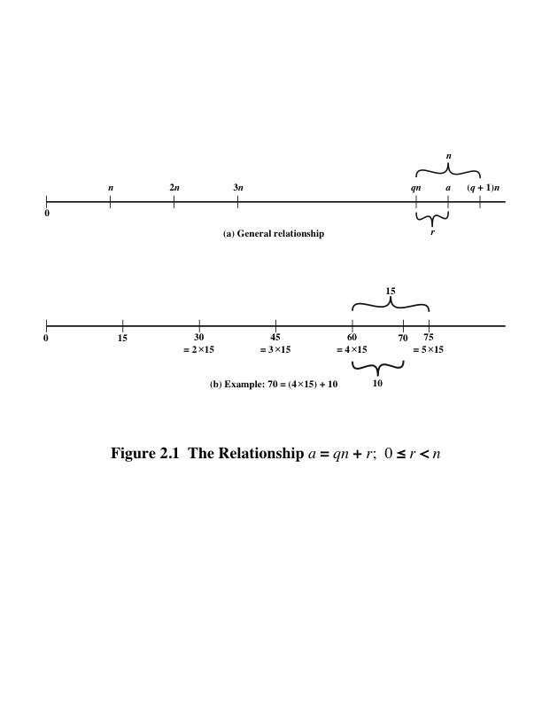
Notes:
Figure 2.1a demonstrates that, given a and positive n, it is always possible to find q and r that satisfy the preceding relationship. Represent the integers on the number line; a will fall somewhere on that line (positive a is shown, a similar demonstration can be made for negative a). Starting at 0, proceed to n, 2n, up to qn such that qn ≤ a and (q + 1)n > a. The distance from qn to a is r, and we have found the unique values of q and r. The remainder r is often referred to as a residue .
For example:
a = 11; n = 7; 11 = 1 x 7 + 4; r = 4 q = 1
a = –11; n = 7; –11 = (–2) x 7 + 3; r = 3 q = –2
Figure 4.1b provides another example.

Slide 8

Euclidean Algorithm
One of the basic techniques of number theory
Procedure for determining the greatest common divisor of two positive integers
Two integers are relatively prime if their only common positive integer factor is 1
Notes:
One of the basic techniques of number theory is the Euclidean algorithm, which
is a simple procedure for determining the greatest common divisor of two positive
integers. First, we need a simple definition: Two integers are relatively prime if their
only common positive integer factor is 1.

Slide 9
Greatest Common Divisor (GCD)
The greatest common divisor of a and b is the largest integer that divides both a and b
We can use the notation gcd(a,b) to mean the greatest common divisor of a and b
We also define gcd(0,0) = 0
Positive integer c is said to be the gcd of a and b if:
  c is a divisor of a and b
  Any divisor of a and b is a divisor of c
  An equivalent definition is:
  gcd(a,b) = max[k, such that k | a and k | b]
Notes:
Recall that nonzero b is defined to be a divisor of a if a = mb for some m , where a , b , and
m are integers. We will use the notation gcd(a , b ) to mean the greatest common divisor
of a and b . The greatest common divisor of a and b is the largest integer that divides
both a and b . We also define gcd(0, 0) = 0.
More formally, the positive integer c is said to be the greatest common divisor
of a and b if
1. c is a divisor of a and of b .
2. Any divisor of a and b is a divisor of c .
An equivalent definition is the following:
gcd(a , b ) = max[k , such that k | a and k | b ]

Slide 10
GCD
Because we require that the greatest common divisor be positive, gcd(a,b) = gcd(a,-b) = gcd(-a,b) = gcd(-a,-b)
In general, gcd(a,b) = gcd(| a |, | b |)
Also, because all nonzero integers divide 0, we have gcd(a,0) = | a |
We stated that two integers a and b are relatively prime if their only common positive integer factor is 1; this is equivalent to saying that a and b are relatively prime if gcd(a,b) = 1
gcd(60, 24) = gcd(60, - 24) = 12
8 and 15 are relatively prime because the positive divisors of 8 are 1, 2, 4, and 8, and the positive divisors of 15 are 1, 3, 5, and 15. So 1 is the only integer on both lists.
Notes:
Because we require that the greatest common divisor be positive, gcd(a , b ) =
gcd(a , -b ) = gcd(-a , b ) = gcd(-a ,-b ). In general, gcd(a , b ) = gcd( | a | , | b | ).
Also, because all nonzero integers divide 0, we have gcd(a , 0) = a .
We stated that two integers a and b are relatively prime if their only common
positive integer factor is 1. This is equivalent to saying that a and b are relatively
prime if gcd(a , b ) = 1.

Slide 11
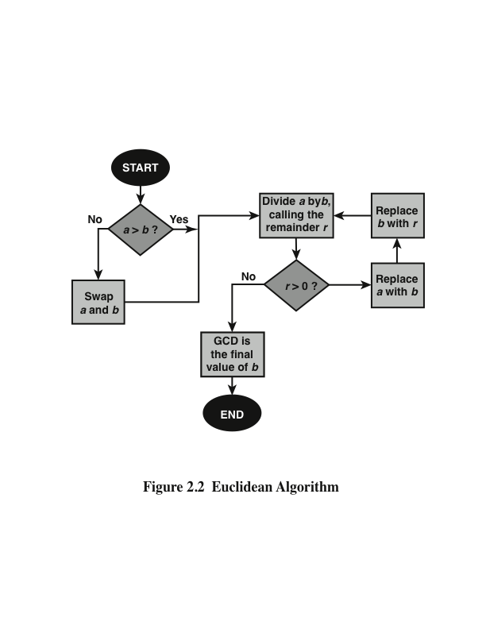
Notes:
We now describe an algorithm credited to Euclid for easily finding the greatest
common divisor of two integers (Figure 2.2). This algorithm has broad significance
in cryptography.

Slide 12
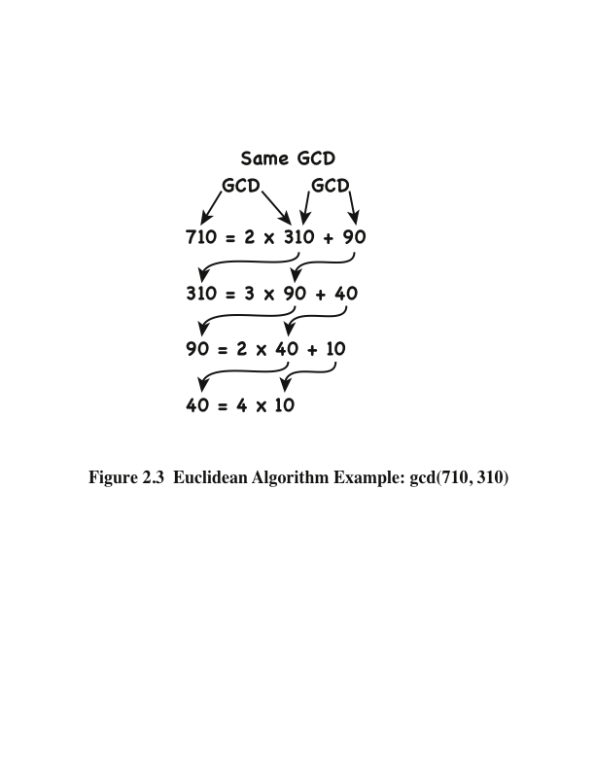
Notes:
We can find the greatest common divisor of two integers by repetitive application
of the division algorithm. This scheme is known as the Euclidean algorithm.
Figure 2.3 illustrates a simple example.

Slide 13
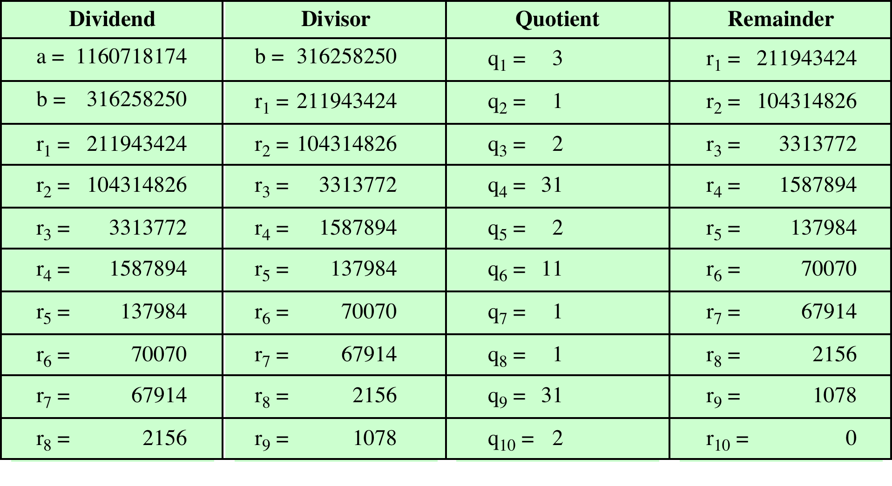
Table 2.1
Euclidean Algorithm Example
(This table can be found on page 34 in the textbook)
Notes:
In this example, we begin by dividing 1160718174 by 316258250, which gives 3
with a remainder of 211943424. Next we take 316258250 and divide it by 211943424.
The process continues until we get a remainder of 0, yielding a result of 1078.

Slide 14
Modular Arithmetic
The modulus
  If a is an integer and n is a positive integer, we define a mod n to be the remainder when a is divided by n; the integer n is called the modulus
  Thus, for any integer a:
  a = qn + r 0 ≤ r < n; q = [a/ n]
  a = [a/ n] * n + ( a mod n)
11 mod 7 = 4; - 11 mod 7 = 3
Notes:
If a is an integer and n is a positive integer, we define a mod n to be the remainder
when a is divided by n . The integer n is called the modulus . Thus, for any integer a:
a = qn + r 0 ≤ r < n; q = [ a/ n]
a = [a/ n] * n + ( a mod n)

Slide 15
Modular Arithmetic
Congruent modulo n
  Two integers a and b are said to be congruent modulo n if (a mod n) = (b mod n)
  This is written as a = b(mod n)²
  Note that if a = 0(mod n), then n | a
73 = 4 (mod 23); 21 = - 9 (mod 10)
Notes:
Two integers a and b are said to be congruent modulo n , if (a mod n ) =
(b mod n ). This is written as a K b (mod n ).²
Note that if a = 0 (mod n ), then n | a .

Slide 16
Properties of Congruences
Congruences have the following properties:
1. a = b (mod n) if n (a – b)
2. a = b (mod n) implies b = a (mod n)
3. a = b (mod n) and b = c (mod n) imply a = c (mod n)
To demonstrate the first point, if n (a - b), then (a - b) = kn for some k
  So we can write a = b + kn
  Therefore, (a mod n) = (remainder when b + kn is divided by n) = (remainder when b is divided by n) = (b mod n)
23 = 8 (mod 5) because 23 - 8 = 15 = 5 * 3
- 11 = 5 (mod 8) because - 11 - 5 = - 16 = 8 * (- 2)
81 = 0 (mod 27) because 81 - 0 = 81 = 27 * 3
Notes:
Congruences have the following properties:
1. a = b (mod n) if n (a – b)
2. a = b (mod n) implies b = a (mod n)
3. a = b (mod n) and b = c (mod n) imply a = c (mod n)
To demonstrate the first point, if n (a - b), then (a - b) = kn for some k
So we can write a = b + kn
Therefore, (a mod n) = (remainder when b + kn is divided by n) = (remainder when b is divided by n) = (b mod n)

Slide 17
Modular Arithmetic
Modular arithmetic exhibits the following properties:
1. [(a mod n) + (b mod n)] mod n = (a + b) mod n
2. [(a mod n) - (b mod n)] mod n = (a - b) mod n
3. [(a mod n) * (b mod n)] mod n = (a * b) mod n
We demonstrate the first property:
  Define (a mod n) = r_{a} and (b mod n) = r_{b}. Then we can write a = r_{a} + jn for some integer j and b = r_{b} + kn for some integer k
  Then:
(a + b) mod n = (ra + jn + rb + kn) mod n
= (ra + rb + (k + j)n) mod n
= (ra + rb) mod n
= [(a mod n) + (b mod n)] mod n
Notes:
Modular arithmetic exhibits the following properties:
1. [(a mod n) + (b mod n)] mod n = (a + b) mod n
2. [(a mod n) - (b mod n)] mod n = (a - b) mod n
3. [(a mod n) * (b mod n)] mod n = (a * b) mod n
We demonstrate the first property:
Define (a mod n) = r_{a} and (b mod n) = r_{b}. Then we can write a = r_{a} + jn for some integer j and b = r_{b} + kn for some integer k.
Then:
(a + b) mod n = (ra + jn + rb + kn) mod n
= (ra + rb + (k + j)n) mod n
= (ra + rb) mod n
= [(a mod n) + (b mod n)] mod n

Slide 18
Remaining Properties:
Examples of the three remaining properties:
11 mod 8 = 3; 15 mod 8 = 7
[(11 mod 8) + (15 mod 8)] mod 8 = 10 mod 8 = 2
(11 + 15) mod 8 = 26 mod 8 = 2
[(11 mod 8) - (15 mod 8)] mod 8 = - 4 mod 8 = 4
(11 - 15) mod 8 = - 4 mod 8 = 4
[(11 mod 8) * (15 mod 8)] mod 8 = 21 mod 8 = 5
(11 * 15) mod 8 = 165 mod 8 = 5
Notes:
The remaining properties are proven as easily. Here are examples of the three
properties.

Slide 19
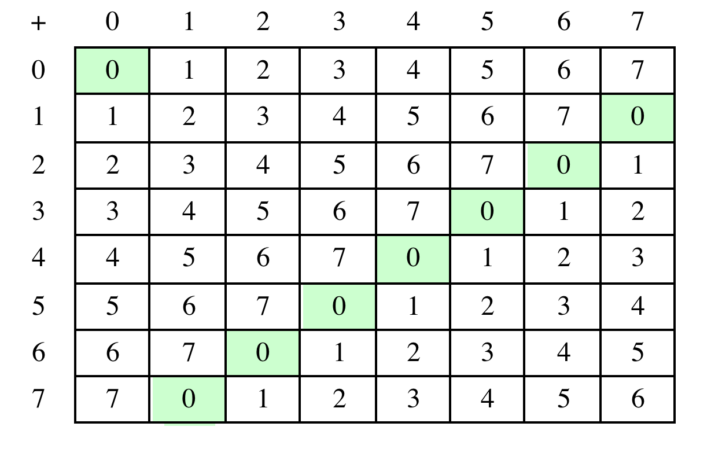
Table 2.2(a)
Arithmetic Modulo 8
(This table can be found on page 37 in the textbook)
Notes:
Table 2.2a and Table 2.2b provide an illustration of modular addition and multiplication
modulo 8. Looking at addition, the results are straightforward, and there is a regular
pattern to the matrix. Both matrices are symmetric about the main diagonal
in conformance to the commutative property of addition and multiplication.

Slide 20
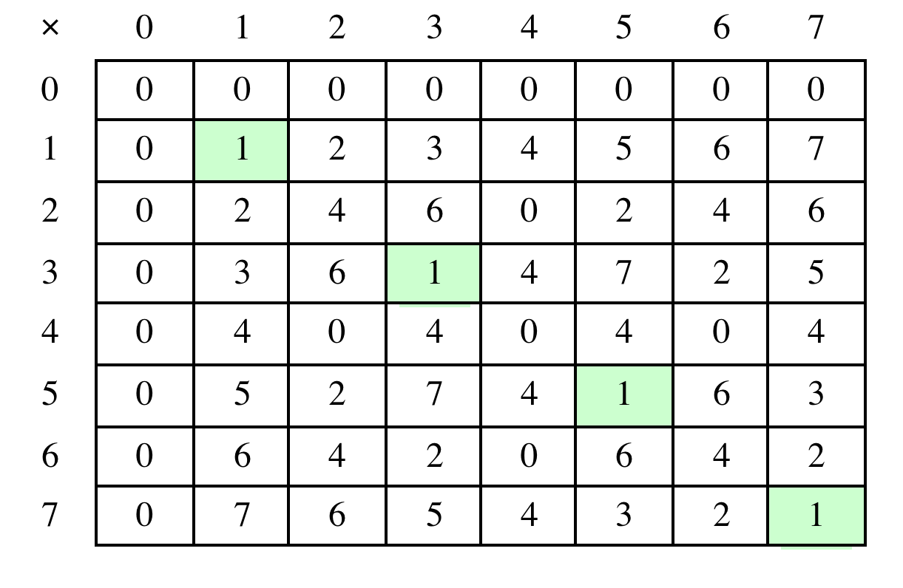
Table 2.2(b)
Multiplication Modulo 8
(This table can be found on page 37 in the textbook)
Notes:
Similarly, the entries in the multiplication table are straightforward. In ordinary
arithmetic, there is a multiplicative inverse, or reciprocal, to each integer. In modular
arithmetic mod 8, the multiplicative inverse of x is the integer y such that
(x * y ) mod 8 = 1 mod 8. Now, to find the multiplicative inverse of an integer
from the multiplication table, scan across the matrix in the row for that integer to
find the value 1; the integer at the top of that column is the multiplicative inverse;
thus, (3 * 3) mod 8 = 1. Note that not all integers mod 8 have a multiplicative
inverse; more about that later.

Slide 21
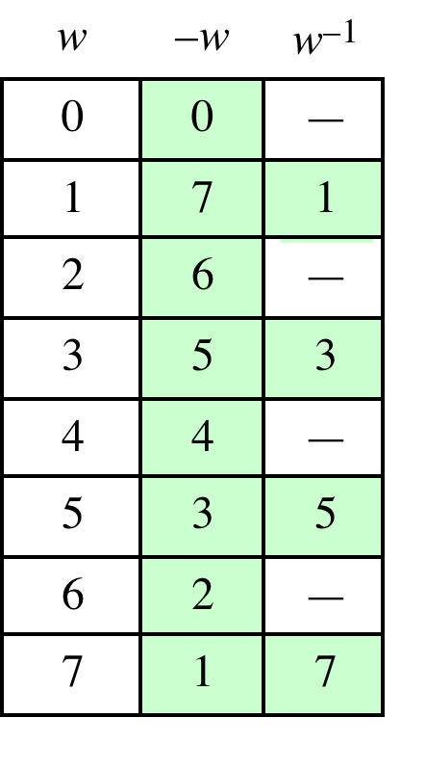
Table 2.2(c)
Additive and
Multiplicative Inverse
Modulo 8
(This table can be found on page 37 in the textbook)
Notes:
As in ordinary addition, there is an additive inverse, or negative, to each integer in
modular arithmetic. In this case, the negative of an integer x is the integer y such
that (x + y ) mod 8 = 0. To find the additive inverse of an integer in the left-hand
column, scan across the corresponding row of the matrix to find the value 0; the
integer at the top of that column is the additive inverse; thus, (2 + 6) mod 8 = 0.

Slide 22
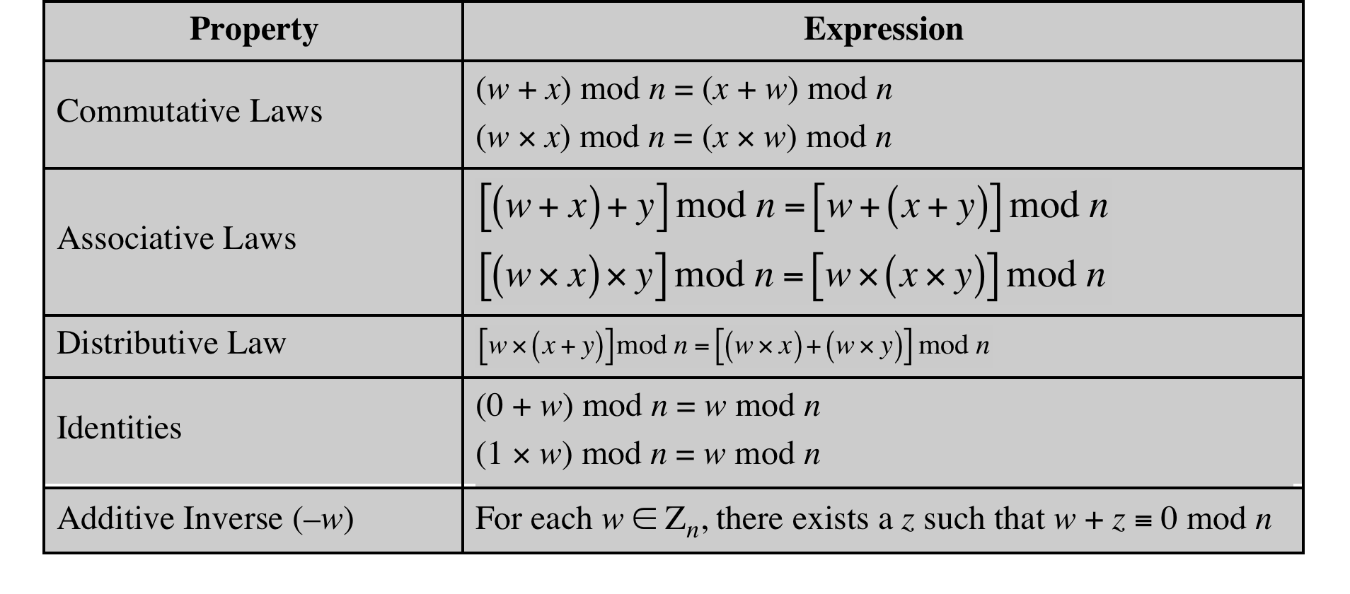
Table 2.3
Properties of Modular Arithmetic for Integers in Z_{n}
(This table can be found on page 38 in the textbook)
Notes:
If we perform modular arithmetic within Z_{n}, the properties shown in Table 2.3 hold for integers in Z_{n} We show in the next section that this implies that Z_{n} is a commutative ring with a multiplicative identity element.
In general, an integer has a multiplicative inverse in Z_{n} if that integer is relatively prime to n. Table 2.2c in the text shows that the integers 1, 3, 5, and 7 have a multiplicative inverse in Z ₈, but 2, 4, and 6 do not.

Slide 23
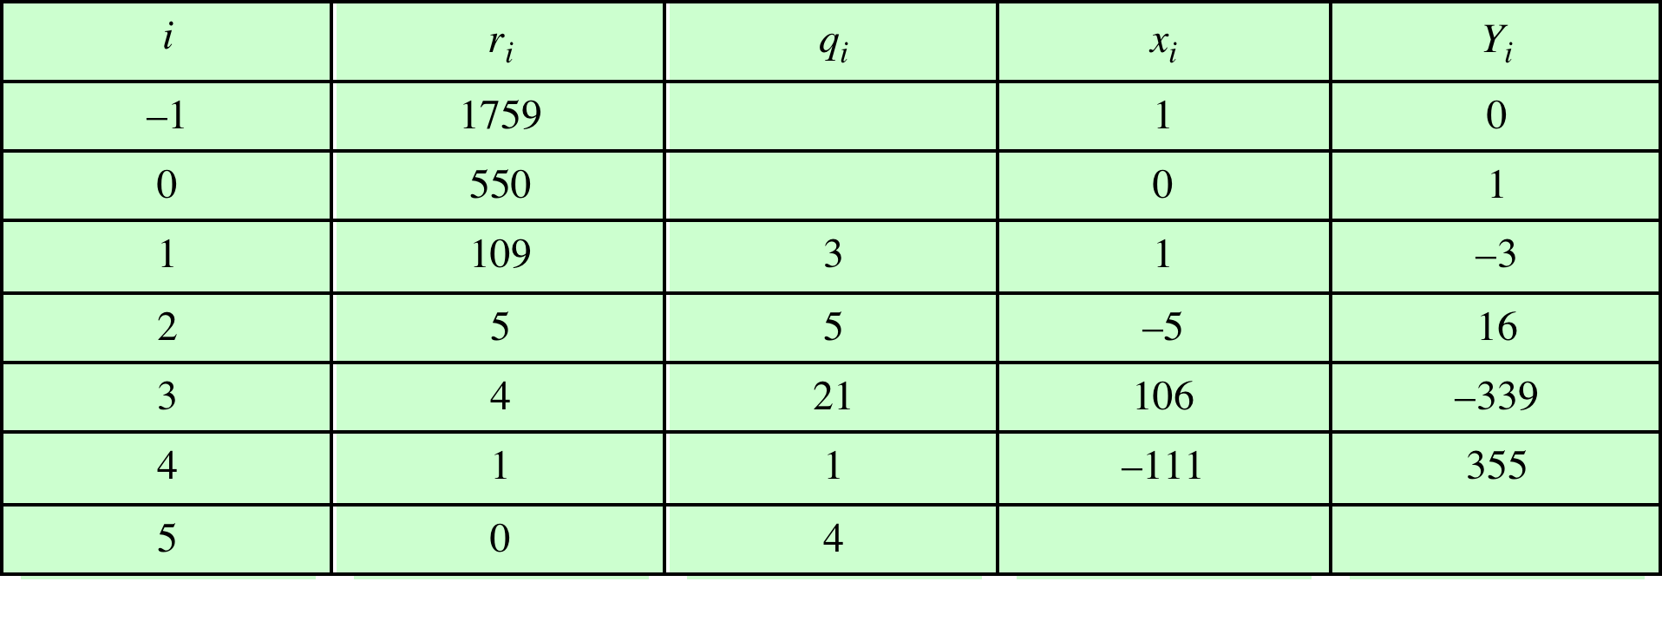
Table 2.4
Extended Euclidean Algorithm Example
Result: d = 1; x = –111; y = 355
(This table can be found on page 43 in the textbook)
Notes:
Example of the Extended Euclidean Algorithm. (See pages 97 – 99 in textbook for details.)

Slide 24
Prime Numbers
Prime numbers only have divisors of 1 and itself
  They cannot be written as a product of other numbers
Prime numbers are central to number theory
Any integer a > 1 can be factored in a unique way as
a = _{p1} ^{a1} * p₂ ^{a2} * . . . * p_{p1} ^{a1}
where p₁ < p₂ < . . . < p_{t} are prime numbers and where each a_{i} is a positive integer
This is known as the fundamental theorem of arithmetic
Notes:
An integer p > 1 is a prime number if and only if its only divisors are ±1
and ± p . Prime numbers play a critical role in number theory and in the techniques
discussed in this chapter.
Any integer a > 1 can be factored in a unique way as
a = _{p1} ^{a1} * p₂ ^{a2} * . . . * p_{p1} ^{a1}
where p₁ < p₂ < . . . < p_{t} are prime numbers and where each a_{i} is a positive integer
This is known as the fundamental theorem of arithmetic; a proof can be found in any text on number theory.

Slide 25
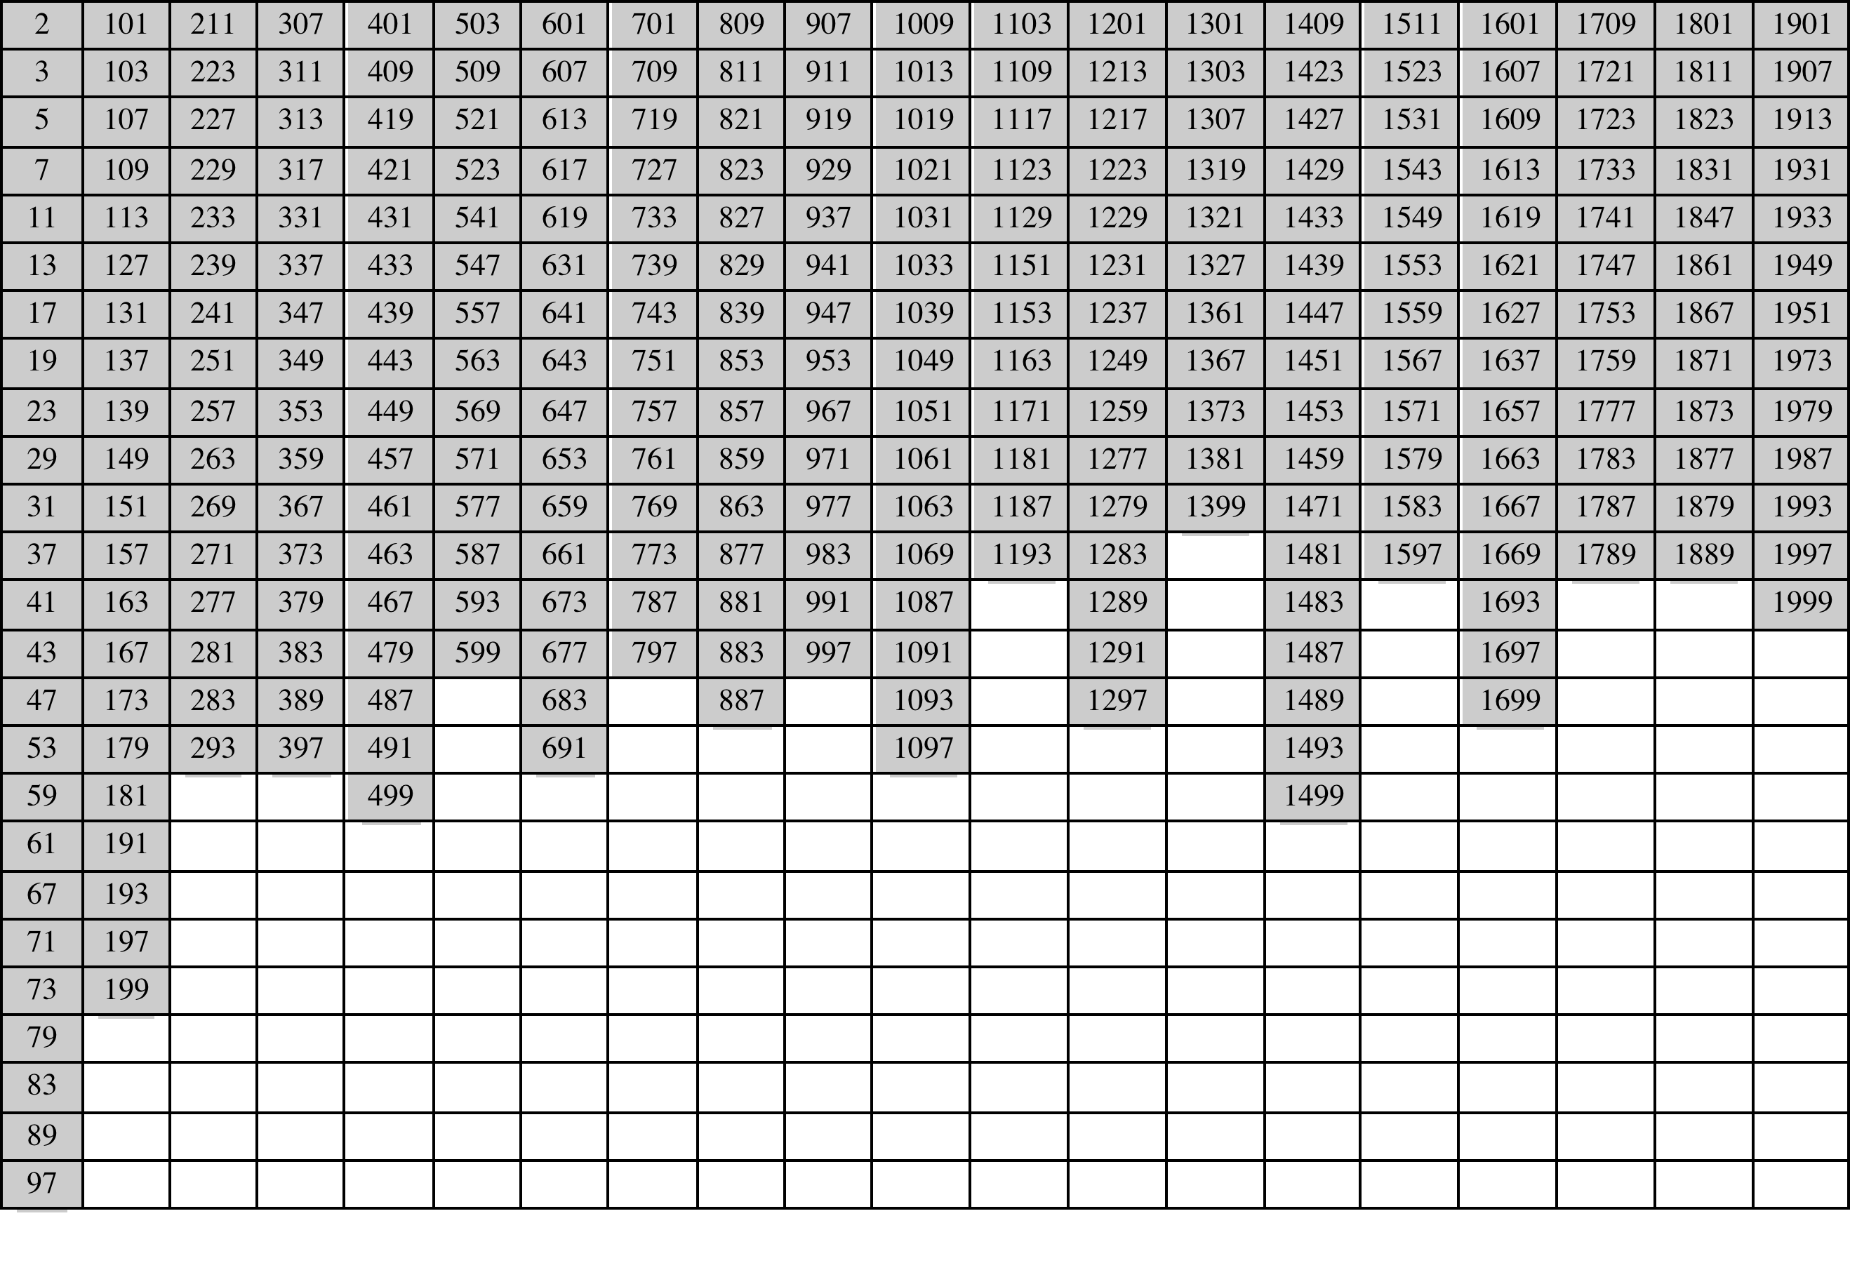
Table 2.5
Primes Under 2000
(This table can be found on page 44 in the textbook)
Notes:
Table 2.5 shows the primes less than 2000. Note the way
the primes are distributed. In particular, note the number of primes in each range
of 100 numbers.

Slide 26
Fermat's Theorem
States the following:
  If p is prime and a is a positive integer not divisible by p then
a^{p-1} = 1 (mod p)
An alternate form is:
  If p is prime and a is a positive integer then
a^{p} = a (mod p)
Notes:
Two theorems that play important roles in public-key cryptography are Fermat’s
theorem and Euler’s theorem.
Fermat’s theorem states the following: If p is prime and a is a positive integer not
divisible by p, then
a^{p-1} = 1 (mod p)
An alternative form of Fermat’s theorem is also useful: If p is prime and a is a
positive integer, then
a^{p} = a (mod p)

Slide 27
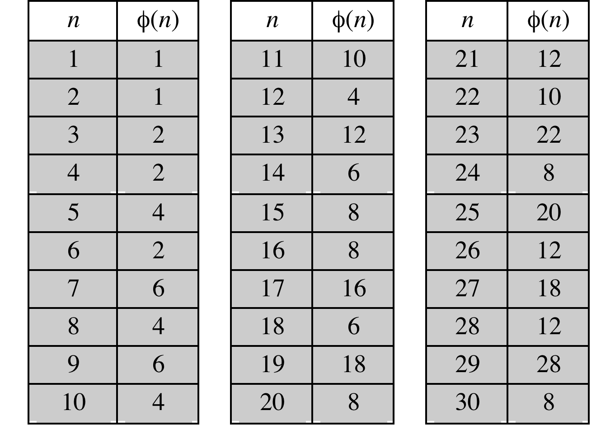
Table 2.6
Some Values of Euler’s Totient Function ø(n)
(This table can be found on page 48 in the textbook)
Notes:
Before presenting Euler’s theorem, we need to introduce an important quantity in
number theory, referred to as Euler’s totient function, written ø (n ), and defined as
the number of positive integers less than n and relatively prime to n . By convention,
ø(1) = 1.
Table 2.6 lists the first 30 values of ø (n ). The value ø(1) is without meaning
but is defined to have the value 1.
It should be clear that, for a prime number p ,
ø (p ) = p - 1

Slide 28
Euler's Theorem
States that for every a and n that are relatively prime:
a^{ø(n)} = 1(mod n)
An alternative form is:
a^{ø(n)+1} = a(mod n)
Notes:
Euler’s theorem states that for every a and n that are relatively prime:
a^{ø(n)} = 1(mod n)
As is the case for Fermat’s theorem, an alternative form of the theorem is also
Useful:
a^{ø(n)+1} = a(mod n)

Slide 29
Miller-Rabin Algorithm
Typically used to test a large number for primality
Algorithm is:
  TEST (n)
Notes:
The algorithm due to Miller and Rabin [MILL75, RABI80] is typically used to test
a large number for primality.
The procedure TEST takes a candidate integer n as input and returns the result composite
if n is definitely not a prime, and the result inconclusive if n may or may not
be a prime.
How can we use the Miller-Rabin algorithm to determine with a high degree of confidence whether or not an integer
is prime? It can be shown [KNUT98] that given an odd number n that is not prime
and a randomly chosen integer, a with 1 < a < n - 1, the probability that TEST
will return inconclusive (i.e., fail to detect that n is not prime) is less than 1/4.
Thus, if t different values of a are chosen, the probability that all of them will pass
TEST (return inconclusive) for n is less than (1/4)^{t} . For example, for t = 10, the
probability that a nonprime number will pass all ten tests is less than 10⁻⁶ . Thus,
for a sufficiently large value of t, we can be confident that n is prime if Miller’s test
always returns inconclusive .
This gives us a basis for determining whether an odd integer n is prime
with a reasonable degree of confidence. The procedure is as follows: Repeatedly
invoke TEST (n) using randomly chosen values for a . If, at any point, TEST returns
composite , then n is determined to be nonprime. If TEST continues to
return inconclusive for t tests, then for a sufficiently large value of t , assume
that n is prime.

Slide 30

Deterministic Primality Algorithm
Prior to 2002 there was no known method of efficiently proving the primality of very large numbers
All of the algorithms in use produced a probabilistic result
In 2002 Agrawal, Kayal, and Saxena developed an algorithm that efficiently determines whether a given large number is prime
  Known as the AKS algorithm
  Does not appear to be as efficient as the Miller-Rabin algorithm
Notes:
Prior to 2002, there was no known method of efficiently proving the primality of very
large numbers. All of the algorithms in use, including the most popular (Miller-Rabin),
produced a probabilistic result. In 2002 (announced in 2002, published in 2004),
Agrawal, Kayal, and Saxena [AGRA04] developed a relatively simple deterministic
algorithm that efficiently determines whether a given large number is a prime. The algorithm,
known as the AKS algorithm, does not appear to be as efficient as the Miller-
Rabin algorithm. Thus far, it has not supplanted this older, probabilistic technique.

Slide 31

Chinese Remainder Theorem (CRT)
Believed to have been discovered by the Chinese mathematician Sun-Tsu in around 100 A.D.
One of the most useful results of number theory
Says it is possible to reconstruct integers in a certain range from their residues modulo a set of pairwise relatively prime moduli
Can be stated in several ways
Notes:
One of the most useful results of number theory is the Chinese remainder theorem
(CRT). In essence, the CRT says it is possible to reconstruct integers in a certain
range from their residues modulo a set of pairwise relatively prime moduli.
The CRT can be stated in several ways. We present here a formulation that is most
useful from the point of view of this text. An alternative formulation is explored in
Problem 2.33.
One of the useful features of the Chinese remainder theorem is that it provides
a way to manipulate (potentially very large) numbers mod M in terms of tuples of
smaller numbers. This can be useful when M is 150 digits or more. However, note
that it is necessary to know beforehand the factorization of M .

Slide 32
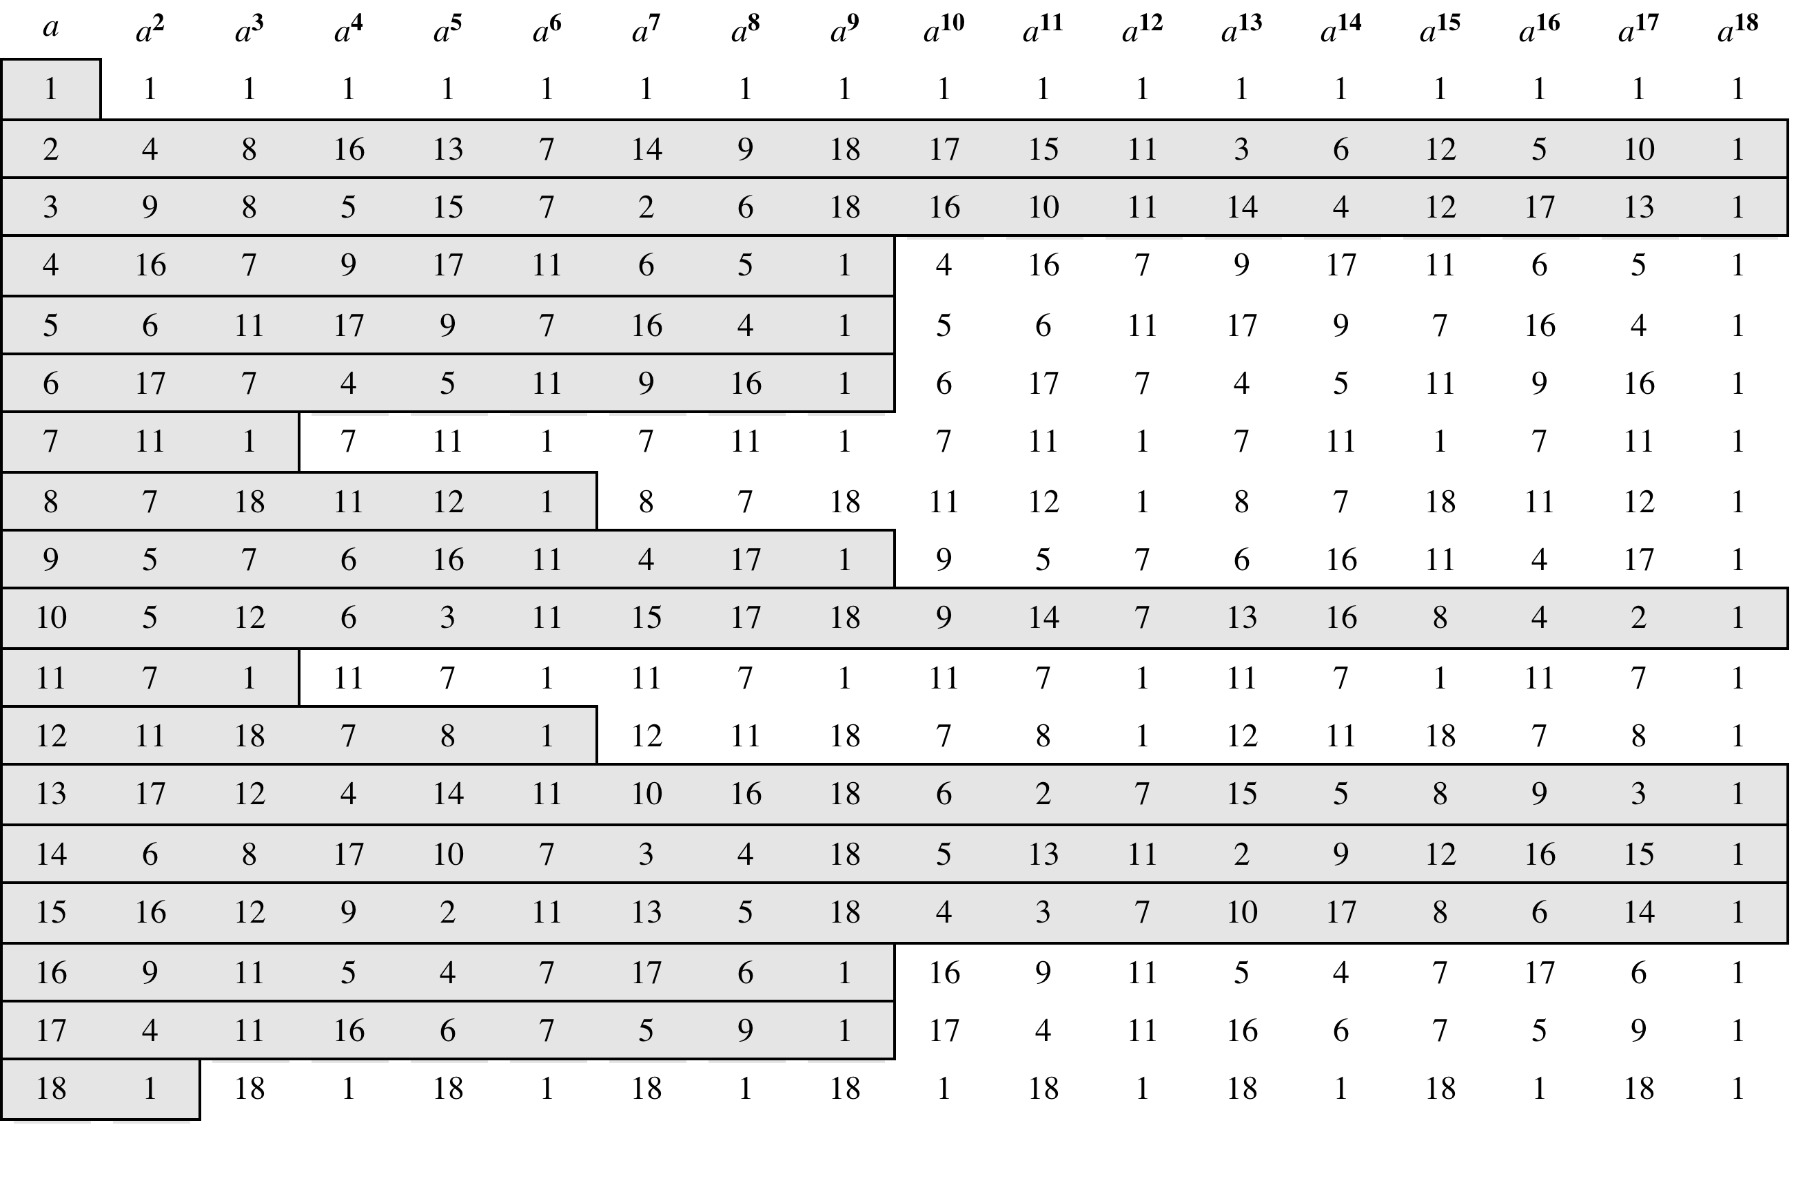
Table 2.7
Powers of Integers, Modulo 19
(This table can be found on page 57 in the textbook)
Notes:
Table 2.7 shows all the powers of a, modulo 19 for all positive a <19. The
length of the sequence for each base value is indicated by shading. Note the
following:
1. All sequences end in 1. This is consistent with the reasoning of the preceding
few paragraphs.
2. The length of a sequence divides ø (19) = 18. That is, an integral number of
sequences occur in each row of the table.
3. Some of the sequences are of length 18. In this case, it is said that the base
integer a generates (via powers) the set of nonzero integers modulo 19. Each
such integer is called a primitive root of the modulus 19.
More generally, we can say that the highest possible exponent to which a number
can belong (mod n ) is ø (n ). If a number is of this order, it is referred to as a
primitive root of n . The importance of this notion is that if a is a primitive root of n ,
then its powers
a , a² ,. . . , a^{ø(n)}
are distinct (mod n ) and are all relatively prime to n . In particular, for a prime number
p , if a is a primitive root of p , then
a , a² ,. . . , a^{p-1}
are distinct (mod p ). For the prime number 19, its primitive roots are 2, 3, 10, 13, 14,
and 15.
Not all integers have primitive roots. In fact, the only integers with primitive
roots are those of the form 2, 4, pª , and 2pª , where p is any odd prime and a is a
positive integer. The proof is not simple but can be found in many number theory
books, including [ORE76].

Slide 33
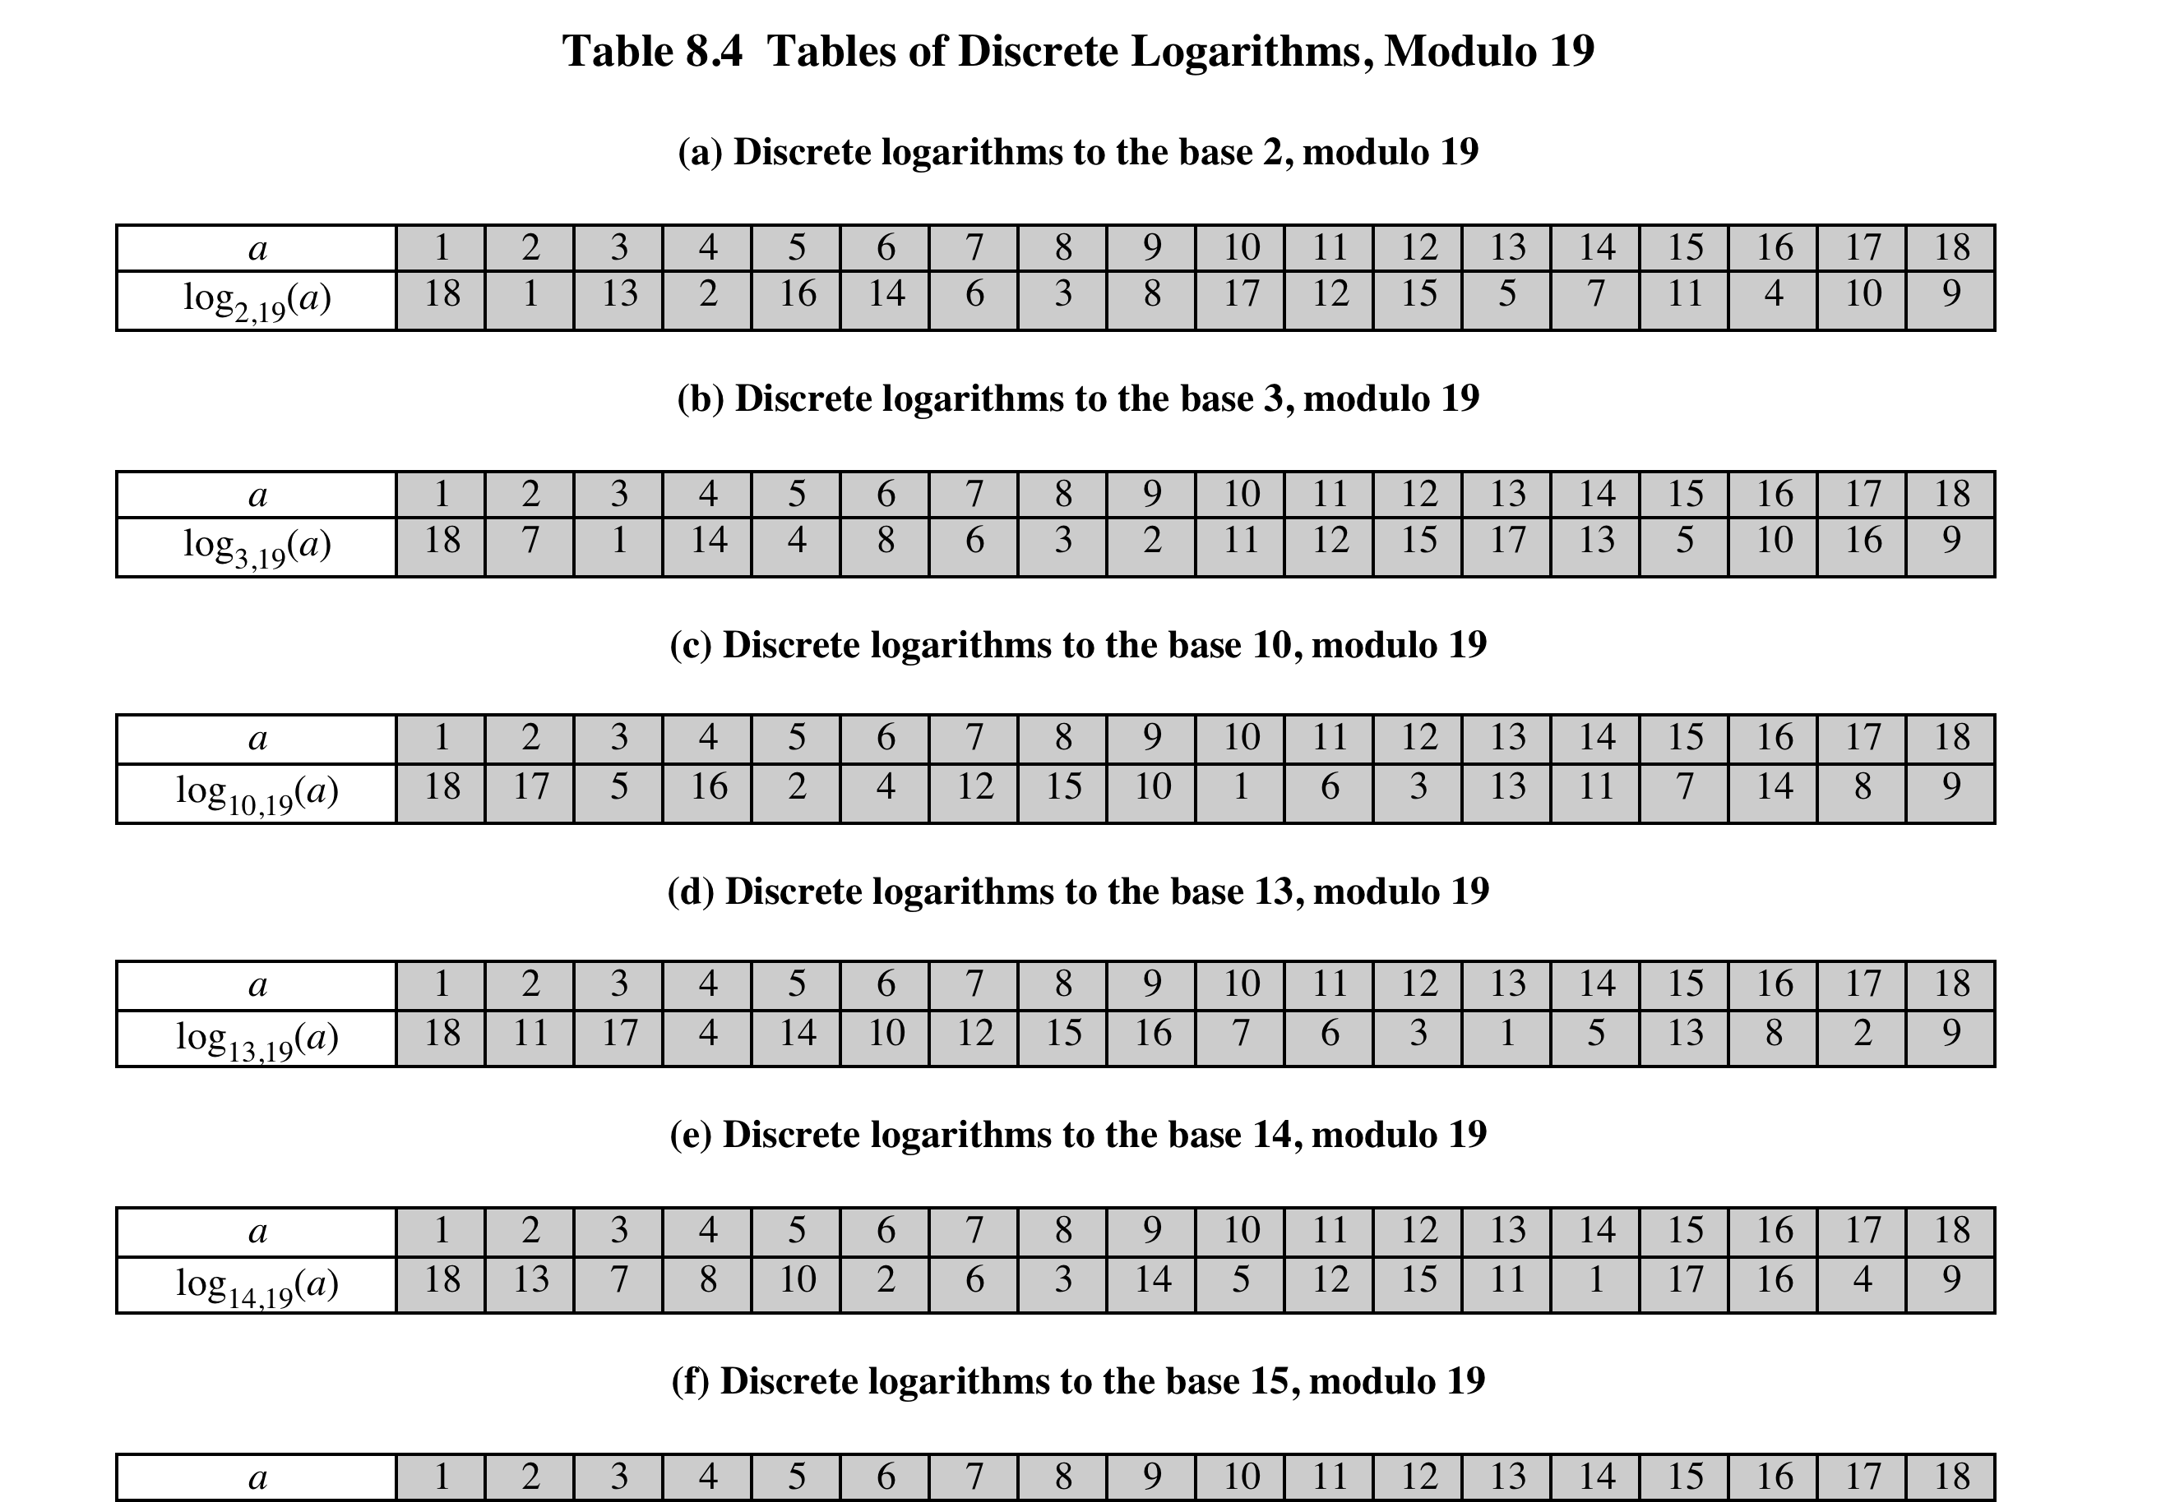
Table 2.8
Tables of Discrete Logarithms, Modulo 19
(This table can be found on page 60 in the textbook)
Notes:
Table 2.8, which is directly derived from Table 2.7, shows the sets of discrete
logarithms that can be defined for modulus 19.

Slide 34
Summary
Divisibility and the division algorithm
The Euclidean algorithm
  Greatest Common Divisor
  Finding the Greatest Common Divisor
Modular arithmetic
  The modulus
  Properties of congruences
  Modular arithmetic operations
  Properties of modular arithmetic
  Euclidean algorithm revisited
  The extended Euclidean algorithm
Prime numbers
Fermat’s Theorem
Euler’s totient function
Euler’s Theorem
Testing for primality
  Miller-Rabin algorithm
  A deterministic primality algorithm
  Distribution of primes
The Chinese Remainder Theorem
Discrete logarithms
  Powers of an integer, modulo n
  Logarithms for modular arithmetic
  Calculation of discrete logarithms
Notes:
Chapter 2 summary.

